Slide 1
Azure B2C
Workshop

Slide 2

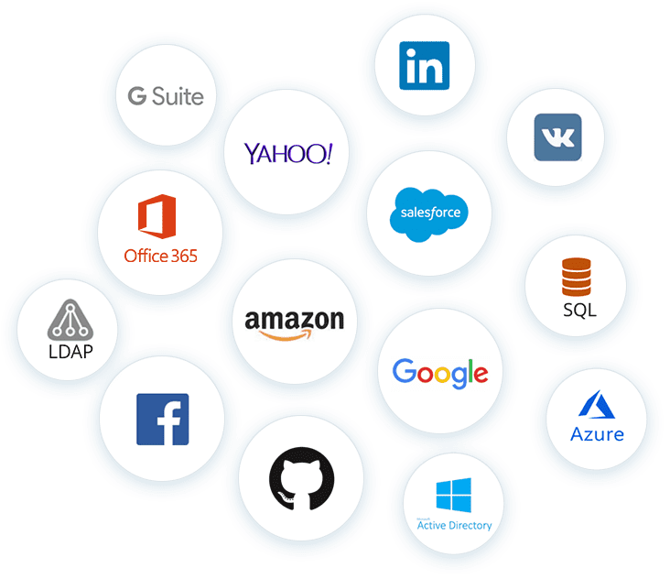



Overview
What is Azure Active Directory B2C?
Custom-branded identity solution
Single Sign On
Integrable with external user stores
Progressive profiling
More…
Notes:
All docs: https://learn.microsoft.com/en-us/azure/active-directory-b2c/
Links: https://learn.microsoft.com/en-us/azure/active-directory-b2c/overview

Slide 3
What is Azure Active Directory B2C?
Business-to-customer (B2C) identity as a service
Customer Identity Access Management (CIAM)
Authenticate customers with “almost any” identity provider
Customizable solution (Branding)
Scalable, secure, monitorizable
Integrable with external user stores
Progressive profiling
Third-party identity verification and profiling
Notes:
Es una solución CIAM, identity as a service (IDaaS)
No confundir con Azure AD.
Muy customizable, pero con sus contras:
- Uso de políticas complejas en XML.
Links: https://learn.microsoft.com/en-us/azure/active-directory-b2c/overview

Slide 4
AAD vs B2B vs B2C
Azure AD
Directory services that allows identity administration in the cloud Identities are NOT considered external Target: Employees
Azure B2B
Azure AD feature that allows to invite users from other tenants to access applications, Azure resources… Identities ARE considered external Target: Colaboration
Azure B2C
Identity-as-a-Service Identities ARE considered external Access using local or social accounts Target: Comerce
Notes:
Explicar principales diferencias entre AD y AD B2C.

Slide 5

Custom-branded identity solution
We can customize the entire user expirience with our brand
Using basic options in Azure Portal
Complete redisign with HTML, CSS and JS
Some tags are disabled: script, iframe
Javascript support is limited to specific JQuery versions
Most Javascript frameworks are not supported
Notes:
Personalización básica desde el Azure Portal.
Podemos personalizar todo el user-journey con nuestros propios ficheros (siguiendo la jerarquía de ficheros que nos marca Microsoft).
Necesitaremos alojar todo esto en publicamente y con el CORS adecuado.
Links: https://learn.microsoft.com/en-us/azure/active-directory-b2c/overview

Slide 6
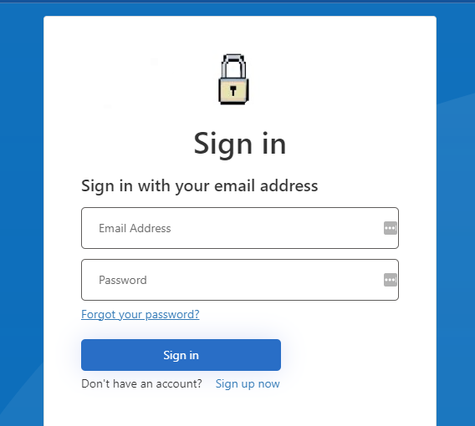
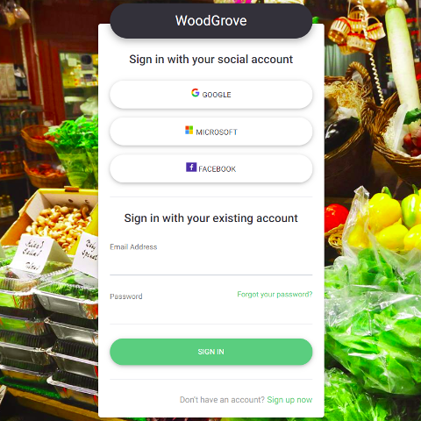
Custom-branded solution
Notes:
Ejemplos:
Izquierda: personalización básica con el portal de Azure.
Derecha: personalización total de HTML, CSS y JS.
Links: https://learn.microsoft.com/en-us/azure/active-directory-b2c/overview

Slide 7
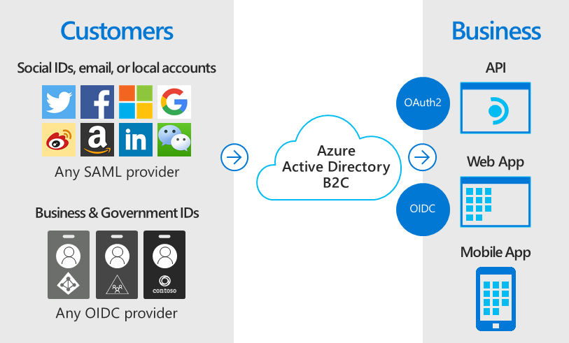
Single Sign-On
Uses standard authentication protocols to integrate with most aplications:
OIDC
OAuth 2.0
SAML 2.0*
*Only for defined providers
Notes:
Azure B2C es compatible con todos aquellos proveedores de identidad que sigan alguno de los estandar OIDC, OAuth 2.0 o SAML 2.0.
Esto nos abre muchas posibilidades. Integraciones con multiples proveedores sociales ya integrados en el portal, otros son configurables de manera manual.
Nosotoros usamos OAuth2.0 y OIDC para comunicarnos con Azure B2C.
Links: https://learn.microsoft.com/en-us/azure/active-directory-b2c/overview

Slide 8
Much more…
Integrating with external user stores
Progressive profiling to collect information (using third parties is supported)
Supports up to 100 attributes per user
Can connect to external stores during signup or profile editing
Customizable user journeys to collect information in a progressive way
We can use third-party services for verification and profiling
Notes:
Podemos hacer mucho más:
Integrarnos con bases de datos de usuarios externas, que sean nuestro “punto de verdad” de los datos de nuestros usuarios (y actualizarlos si lo necesitamos). Plantearía las buenas prácticas de mantener tokens lo mas pequeños posibles
Podemos customizar como queramos el viaje de usuario de tal manera que:
Podemos recopilar información de forma progresiva.
Podemos usar servicios de terceros para verificación o profiling.
Verificación de documentos oficiales.
Verificación anti-bots: reCAPTCHA…
Verificación de IPs, riesgos y otros.
Links: https://learn.microsoft.com/en-us/azure/active-directory-b2c/overview

Slide 9
Demo time!
Creating our own Azure AD B2C tenant and our first application
Required:
Azure Account with AD permissions
Notes:
Creación de un tenant de Azure B2C desde cero (todo mediante el portal de Azure):
Desde plaindevelopment creamos una instancia de Azure B2C con un nuevo nombre (ojo a los tiempos que le cuesta un tanto…)
Registramos nuestra primera aplicación y argumentamos el por qué:
Antes de cualquier interacción con B2C, las aplicaciones deben de estar registradas en el tenant correspondiente.
Detalles de registro:
Cualquier nombre.
Account type: Accounts in any identity provider.
Redirect URI (Web): https://jwt.ms
Permissions: Grant admin consent to openid and offline_access
Creamos un secreto:
Cualquier configuración.
En authentication marcamos los boxes de Implicit grant and hybrid flows (solamente por el hecho de probar con jwt.ms).
Links: https://learn.microsoft.com/en-us/azure/active-directory-b2c/tutorial-register-applications?tabs=app-reg-ga

Slide 10
Basic Flows
Sing up and/or sign in
Profile editing
Password reset
Notes:
User flows disponibles:
Sign up and sign in:
Crear una cuenta o entrar con tu cuenta.
Profile editing:
Habilita a un usuario configurar sus atributos de usuario.
Password reset:
Habilita la posibilidad al usuario de resetear su contraseña después de verificar su email.
Sign up:
Habilita la posibilidad de alta de usuario.
Sign in:
Habilita la posibilidad de autenticación de usuarios ya existentes.
Sign in using resource owner password credentials (ROPC) – NO RECOMENDADO:
ROPC no se recomienda nunca, es un flujo con muchos vectores de ataque y fragil en general.
Links: https://portal.azure.com/#view/Microsoft_AAD_B2CAdmin/NewUserJourneyCreateFlowsBlade/tenantId/supersecureauth.onmicrosoft.com/isCiamTenant~/false

Slide 11
Demo time!
Setting up multiple user flows and testing them
Sign up and sign in with internal users
Password reset
Profile editing
Notes:
Usamos un tenant de Azure B2C anteriormente creado y de forma interactiva vamos creando diferentes flujos con la aplicación creada (todo mediante el portal de Azure):
Signup and signin simple.
Password reset.
Profile editing simple con dirección (p.ej).

Slide 12
1st Exercise

Slide 13
Applications
Web applications (SSR)
Single-page applications (SPA)
Web APIs
Mobile and Native
Server-side applications
Notes:
Podemos usar varios tipos de aplicaciones para interactuar con Azure B2C (para todos se usará OAuth 2.0 y OIDC).
Siempre usaremos Authentication Code + PKCE (siempre que sea posible).
Tipos:
- Web applications (SSR)
- Single-page applications (SPA)
- Web APIs
- Mobile and Native
- Server-side applications
No soporta delegación (on-behalf-of flow): llamadas encadenadas entre APIs autenticadas.
Return URL, secrets, types…
Escenario complejo de interacción entre aplicaciones.
Link: https://learn.microsoft.com/en-us/azure/active-directory-b2c/application-types

Slide 14
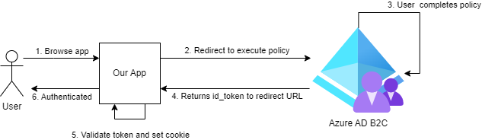
Azure B2C interaction with apps
Notes:
1 – El usuario entra a la aplicación
2 – La aplicación redirige a Azure AD B2C indicando la politica a ejecutar.
3 – El usuario completa la politica.
4 – Azure AD B2C devuelve un id_token al navegador y hace post a la URL de redirección.
5 – Nuestra aplicación valida el id_token y setea una cookie al usuario.
6 – El usuario está autenticado y puede mostrarle una “página segura”.
Link: https://learn.microsoft.com/en-us/azure/active-directory-b2c/application-types

Slide 15
Demo time!
Setting up our .NET app to authenticate users via Azure AD B2C
Sign in with Azure AD B2C with our app
Showing an authenticated page to the user
Notes:
Creamos una aplicación simple en .NET que haga auth contra Azure B2C y muestre una página de “success”.
Ejemplo en ruta: /B2CAuthDemo/B2CAuthDemo.sln

Slide 16
2nd Exercise

Slide 17
Identity Providers
Out-of-the-box identity providers support (Amazon, Apple, Facebook, etc.)
Custom OIDC providers
Notes:
Se pueden añadir y restringir proveedores de identidad por aplicación.
Azure AD B2C provee de varios identity providers fácilmente configurables:
Amazon
Apple
Facebook
Github (Preview)
Google
LinkedIn
Microsoft
QQ (Preview)
Twitter
WeChat (Preview)
Weibo (Preview)
No obstante podemos configurar de forma facil desde el portal o mediante políticas otros proveedores de identidad que sigan los estandar de OIDC y OAuth 2.0.

Slide 18
Demo time!
Adding an OIDC provider
Using Orein (a custom Identity Server based on Duende Identity Server)
Creating a client for Azure AD B2C
Settting up Orein connection in the Azure Portal
Adding the provider to our app and testing it
Notes:
Vamos a https://oreinadmin.azurewebsites.net/ y creamos un cliente Web (SPA) para unir con Azure B2C (el servidor de identidad está en https://orein.azurewebsites.net/). O elegimos https://demo.duendesoftware.com/.
Como backup tenemos el cliente:
B2C_1_SimpleSingUpSignIn
Secret: SampleSecret
Ojo con las redirect URIs (ajustar convenientemente)
Añadimos a Azure B2C el proveedor.
Lo añadimos también a nuestro flujo.
Probamos con la aplicación.

Slide 19
3rd Exercise

Slide 20
Attributes
Built-in set of attributes
Extensible user profile without external storage
Notes:
Los atributos de extensión se guardan en la app b2c-extensions-app.
Siguen la convención de naming: extension_ApplicationClientID_AttributeName
Jugar con:
https://developer.microsoft.com/en-us/graph/graph-explorer?request=users&method=GET&version=v1.0&GraphUrl=https://graph.microsoft.com&sid=815172c0-a2b5-438d-9e41-5557437c58c4
Link: https://learn.microsoft.com/en-us/azure/active-directory-b2c/user-profile-attributes

Slide 21
Attributes
Notes:
Los atributos de extensión se guardan en la app b2c-extensions-app.
Siguen la convención de naming Input: extension_AttributeName
Siguen la convención de naming output: extension_ApplicationClientID_AttributeName
Jugar con:
https://developer.microsoft.com/en-us/graph/graph-explorer?request=users&method=GET&version=beta&GraphUrl=https://graph.microsoft.com
Link: https://learn.microsoft.com/en-us/azure/active-directory-b2c/user-profile-attributes

Slide 22
Demo time!
Adding user attributes and customizing the user input
We will be adding a new attribute to our user flow that we can need
This can be done vía Azure Portal or Custom Policies
We will be using the Azure Portal for now
Notes:
Pillamos alguno de los user-flows que hemos creado anteriormente (p.ej: registro) y añadimos un nuevo atributo (city).
Fallback: supersecureauth.onmicrosoft.com con flow B2C_1_CustomAttribute.
Demo link: https://learn.microsoft.com/en-us/azure/active-directory-b2c/configure-user-input?pivots=b2c-user-flow
Link: https://learn.microsoft.com/en-us/azure/active-directory-b2c/user-profile-attributes

Slide 23
4th Exercise

Slide 24
Personalization
Company branding
Localization
Complete override of HTML, CSS, JS

Slide 25
Demo time!
Custom branding & some changes to the templates (with localization)
Setting branding options in Azure Portal
Changing the default template
Providing localization to our changes
Notes:
Simple demo con assets del directorio assets del repo.
Cambiamos un poco el branding en el Portal de Azure.
Descargamos la template original, hacemos cambios y subimos.
Proporcionamos localización a estos campos.
** Hay una estructura fija que no se puede cambiar: remarcar en la session **
// TODO: Fallback

Slide 26
5th Exercise

Slide 27
Users
Handling users strore
Viewing their sources of identities
Auditing
Notes:
Los usuarios pueden ser vistos directamente desde el recurso del portal.
Podemos tener diferentes tipos de cuentas:
Work account
Guest account (invitado)
Consumer account (dado de alta con B2C por él mismo, usando Graph API o Azure Portal)
Podemos resetear password de usuarios (que no sean externos), restringir cuentas, borrarlas, y migrar a Azure B2C (https://learn.microsoft.com/en-us/azure/active-directory-b2c/user-migration)./
Link: https://learn.microsoft.com/en-us/azure/active-directory-b2c/user-overview

Slide 28
Demo time!
Managing users in Azure Portal
Types of users
Deleting user accounts
Reset user passwords
Blocking users
Risk análisis
Bulk migration
Notes:
Demostrar gestion simple de usuarios en Azure portal.
- Tipos de usuarios
Eliminar usuarios.
Reseteo de contraseña.
Bloqueos de usuario.
Análisis de riesgos.
Volcado masivo.

Slide 29
6th Exercise

Slide 30
API Connectors
Customize
Extend
Integrate
Validate, verify, augment, overwrite…
Notes:
Con API connectors, podemos customizar nuestro flujo de usuario para ejecutar la lógica de negocio que nosotros queramos. Entre ellos:
Validar inputs del usuario.
Verificar al usuario.
Integrar con otros flujos de aprobación.
Aumentar el token con otros atributos.
Sobrescribir atributos del usuario.
Todo tipo de lógica de negocio custom.
Link: https://learn.microsoft.com/en-us/azure/active-directory-b2c/api-connectors-overview?pivots=b2c-user-flow

Slide 31
API Connectors interceptors
Donde se ubican estos API Connectors
Notes:
Donde se ubican estos API Connectors explicar con imagen (draw.io).

Slide 32
Demo time!
Adding an API Connector to use a captcha service during sign-up
We will be using reCAPTCHA to protect against bots and abuse
Providing a custom sign-up user flow
We will be using Azure Functions for this API demo
Notes:
Creamos una API connector de ejemplo haciendo uso del ejemplo “https://github.com/Azure-Samples/active-directory-b2c-node-sign-up-user-flow-captcha”
Para ello vamos a usar los datos de reCAPTCHA:
Key: 6LdhuGUjAAAAAM4vkK5GvqdhWJYyaP9O3OQTWsNd
- Secret: 6LdhuGUjAAAAAOCbzn4T2qWPZSWr4u-AwHVYhxfd
Fallback en supersecureauth.onmicrosoft.com, flujo B2C_1_SimpleSignupSigninWithCaptcha.

Slide 33
7th Exercise

Slide 35
Identity Framework Experience

Slide 36
Why custom policies?
Custom policies are configuration files that define the behavior of your Azure Active Directory B2C tenant
User flows are predefined in the Azure AD B2C portal for the most common identity tasks
Custom policies can be fully edited by an identity developer to complete many different tasks
A custom policy is fully configurable and policy-driven
A custom policy is represented as one or more XML-formatted files, which refer to each other in a hierarchical chain
Notes:
Custom policies are configuration files that define the behavior of your Azure Active Directory B2C (Azure AD B2C) tenant. In this article, you learn how to:
Azure Active Directory B2C custom policy overview | Microsoft Learn
A custom policy is fully configurable and policy-driven. A custom policy orchestrates trust between entities in standard protocols. For example, OpenID Connect, OAuth, SAML, and a few non-standard ones, for example REST API-based system-to-system claims exchanges. The framework creates user-friendly, white-labeled experiences.
Setup app: Home Page - IEF Setup (b2ciefsetupapp.azurewebsites.net)
Starter pack: https://github.com/Azure-Samples/active-directory-b2c-custom-policy-starterpack

Slide 37
Instalation
Tenant
Register Applications
Create Custom Policies
Notes:
Requisitos:
Un tenant de Azure B2C
Permisos para crear aplicaciones en el propio tenant
Creación de políticas custom

Slide 38
Create Tenant Azure B2C
Before your applications can interact with Azure Active Directory B2C, they must be registered in a tenant that you manage.
Create an Azure AD B2C Tenant
Link your tenant to your repository
Switch to the Azure AD B2C tenant directory
Add the Azure AD B2C resource as Favorite in the Azure Portal
Notes:
Link documentación Tutorial - Create an Azure Active Directory B2C tenant | Microsoft Learn
Prerequisites
An Azure subscription. If you don't have one, create a free account before you begin.
An Azure account that's been assigned at least the Contributor role within the subscription or a resource group within the subscription is required.
Note
You can create up to 20 tenants per subscription
You can link multiple Azure AD B2C tenants to a single Azure subscription for billing purposes. To link a tenant, you must be an admin in the Azure AD B2C tenant and be assigned at least a Contributor role within the Azure subscription. See Link an Azure AD B2C tenant to a subscription.

Slide 39
Register a web application
Before your applications can interact with Azure Active Directory B2C, they must be registered in a tenant that you manage
Register web application
Crete a client secret
Enable ID token impicit grant
Notes:
Documentation Applications. Application types supported by Azure AD B2C - Azure AD B2C | Microsoft Learn
In a web application, each execution of a policy takes these high-level steps:
The user browses to the web application.
The web application redirects the user to Azure AD B2C indicating the policy to execute.
The user completes policy.
Azure AD B2C returns an id_token to the browser.
The id_token is posted to the redirect URI.
The id_token is validated and a session cookie is set.
A secure page is returned to the user.
Types:
Single-page applications
Authorization code flow (with PKCE)
Implicit grant flow
Web APIs
Mobile and native applications
Daemons/server-side applications

Slide 40
Create custom policies
Custom policies are configuration files that define the behavior of your Azure Active Directory B2C tenant
Create Policy Keys
Register Identity Experience Framework applications
Dowload/Upload policies
Custom policies “starter pack”
Notes:
Custom policies are configuration files that define the behavior of your Azure Active Directory B2C (Azure AD B2C) tenant. In this article, you learn how to:
Azure Active Directory B2C custom policy overview | Microsoft Learn
Setup app: Home Page - IEF Setup (b2ciefsetupapp.azurewebsites.net)
Starter pack: https://github.com/Azure-Samples/active-directory-b2c-custom-policy-starterpack

Slide 41
Ejercicio 1.
Notes:
Tutorial: Register a web application in Azure Active Directory B2C - Azure AD B2C | Microsoft Learn
Ejercicio 1.
Registrar una web application
Search for Policy Keys
Search for Identity Experience Framework and validate (miss grant consent)
Download policies from repo
Change application identifiers
Change policies references by _iniciales
Upload + Test

Slide 42
Custom Policy Schema
Trust Framework Policy
Building Blocks
Claims Providers
User Journeys
Reliying Party
Claim Resolvers
Notes:
Puede interesar tener como referencia: https://azure-ad-b2c.github.io/azureadb2ccommunity.io/docs/custom-policy-concepts/. Hacen un overwiew de todas las secciones de manera muy simplificada

Slide 43
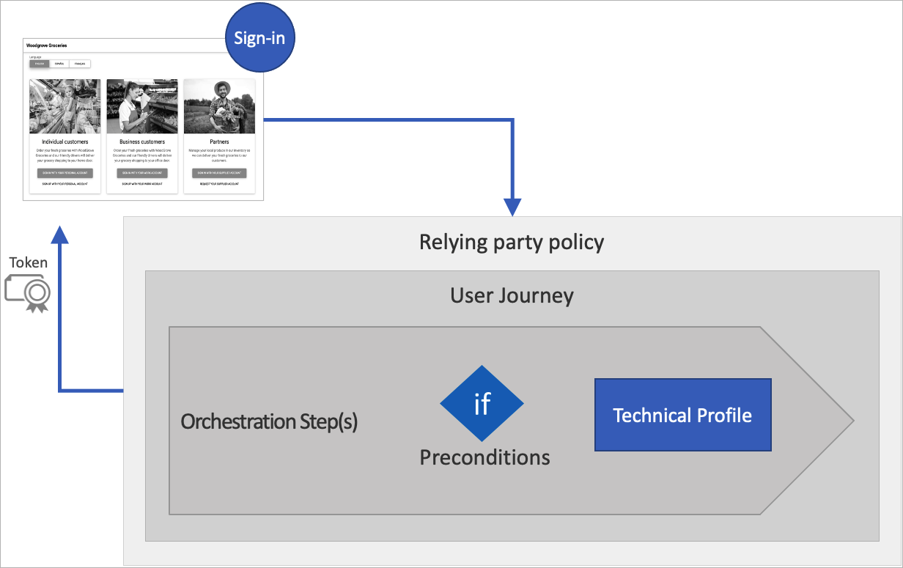
Relying party
Notes:
Custom policies are configuration files that define the behavior of your Azure Active Directory B2C (Azure AD B2C) tenant. In this article, you learn how to:
Azure Active Directory B2C custom policy overview | Microsoft Learn
Setup app: Home Page - IEF Setup (b2ciefsetupapp.azurewebsites.net)
Starter pack: https://github.com/Azure-Samples/active-directory-b2c-custom-policy-starterpack

Slide 44
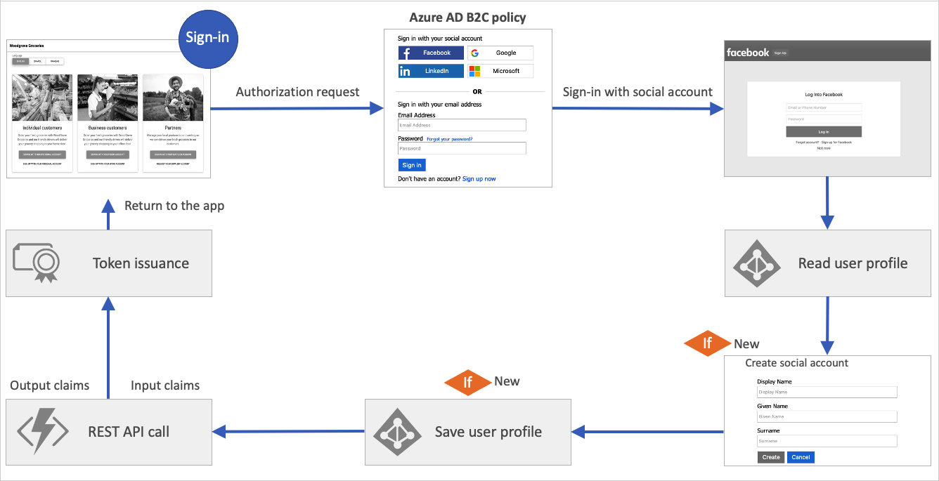
User journey
Notes:
Custom policies are configuration files that define the behavior of your Azure Active Directory B2C (Azure AD B2C) tenant. In this article, you learn how to:
Azure Active Directory B2C custom policy overview | Microsoft Learn
Setup app: Home Page - IEF Setup (b2ciefsetupapp.azurewebsites.net)
Starter pack: https://github.com/Azure-Samples/active-directory-b2c-custom-policy-starterpack

Slide 45
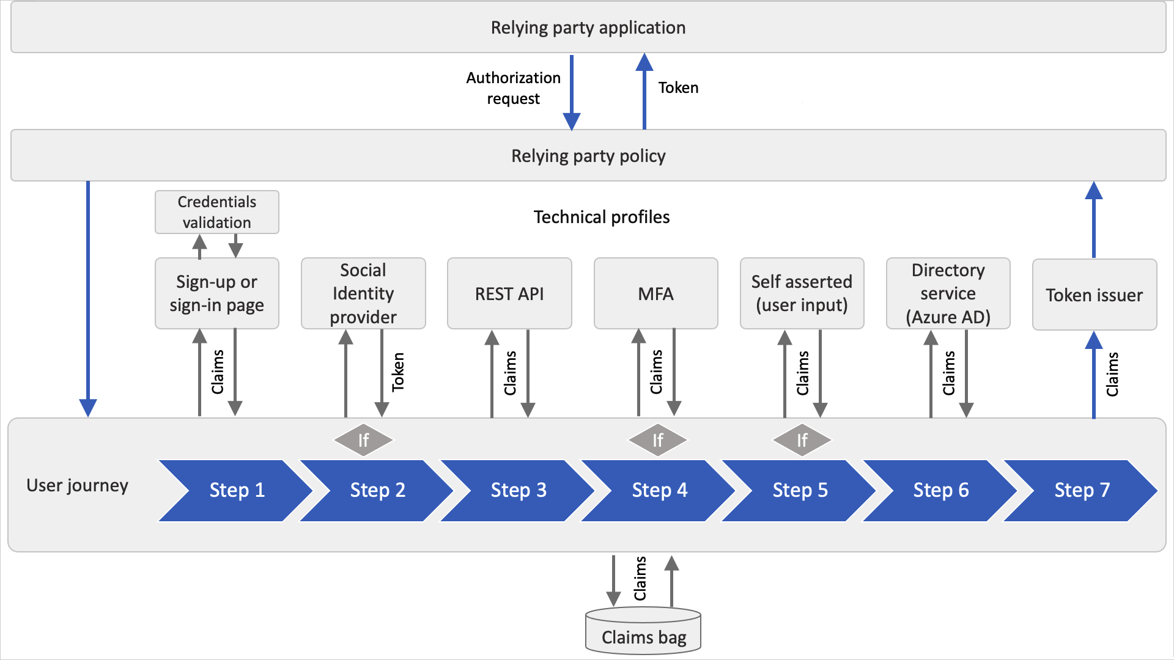
Orchestration steps
Notes:
The orchestration step references to a method that implements its intended purpose or functionality. This method is called a technical profile. When your user journey needs branching to better represent the business logic, the orchestration step references to sub journey. A sub journey contains its own set of orchestration steps.
A user must reach the last orchestration step in the user journey to acquire a token. But users may not need to travel through all of the orchestration steps. Orchestration steps can be conditionally executed based on preconditions defined in the orchestration step.
After an orchestration step completes, Azure AD B2C stores the outputted claims in the claims bag. The claims in the claims bag can be utilized by any further orchestration steps in the user journey.
The following diagram shows how the user journey's orchestration steps can access the claims bag.
Setup app: Home Page - IEF Setup (b2ciefsetupapp.azurewebsites.net)
Starter pack: https://github.com/Azure-Samples/active-directory-b2c-custom-policy-starterpack

Slide 46
Trust Framework Policy
Trust Framework Policy
Base Policy
Policy Flow

Slide 47
Trust Framework Policy
<TrustFrameworkPolicy
xmlns:xsi="https://www.w3.org/2001/XMLSchema-instance"
xmlns:xsd="https://www.w3.org/2001/XMLSchema"
xmlns="http://schemas.microsoft.com/online/cpim/schemas/2013/06"
PolicySchemaVersion="0.3.0.0"
TenantId="yourtenant.onmicrosoft.com"
PolicyId="B2C_1A_TrustFrameworkBase"
PublicPolicyUri="http://yourtenant.onmicrosoft.com/B2C_1A_TrustFrameworkBase">
...
Notes:
A custom policy se representa como uno o más archivos con formato XML que se hacen referencia entre sí en una cadena jerárquica. Los elementos XML definen los elementos de la policy, como el claims schema, claims transformations, content definitions, claims providers, technical profiles, user journey, and orchestration steps.
Cada política se define con el elemento TrustFrameworkPolicy de nivel superior de un archivo de policy.

Slide 48
Attribute | Required | Description
PolicySchemaVersion | Yes | The schema version that is to be used to execute the policy. The value must be 0.3.0.0
TenantObjectId | No | The unique object identifier of the Azure Active Directory B2C (Azure AD B2C) tenant.
TenantId | Yes | The unique identifier of the tenant to which this policy belongs.
PolicyId | Yes | The unique identifier for the policy. This identifier must be prefixed by B2C_1A_
PublicPolicyUri | Yes | The URI for the policy, which is combination of the tenant ID and the policy ID.
DeploymentMode | No | Possible values: Production, or Development. Production is the default. Use this property to debug your policy.
UserJourneyRecorderEndpoint | No | The endpoint that is used for logging. The value must be set to urn:journeyrecorder:applicationinsights if the attribute exists.
Notes:
El elemento TrustFrameworkPolicy contiene los atributos siguientes:

Slide 49
Element | Occurrences | Description
BasePolicy | 0:1 | The identifier of a base policy.
BuildingBlocks | 0:1 | The building blocks of your policy.
ClaimsProviders | 0:1 | A collection of claims providers.
UserJourneys | 0:1 | A collection of user journeys.
SubJourneys | 0:1 | A collection of sub journeys.
RelyingParty | 0:1 | A definition of a relying party policy.
Notes:
El elemento TrustFrameworkPolicy contiene los elementos siguientes:

Slide 50
Base Policy
<TrustFrameworkPolicy
xmlns:xsi="https://www.w3.org/2001/XMLSchema-instance"
xmlns:xsd="https://www.w3.org/2001/XMLSchema"
xmlns="http://schemas.microsoft.com/online/cpim/schemas/2013/06"
PolicySchemaVersion="0.3.0.0"
TenantId="yourtenant.onmicrosoft.com"
PolicyId="B2C_1A_TrustFrameworkBase"
PublicPolicyUri="http://yourtenant.onmicrosoft.com/B2C_1A_TrustFrameworkBase">
<BasePolicy>
<TenantId>yourtenant.onmicrosoft.com</TenantId>
<PolicyId>B2C_1A_TrustFrameworkBase</PolicyId>
</BasePolicy>
...
</TrustFrameworkPolicy>
Notes:
Para heredar una directiva de otra directiva, es necesario declarar un elemento BasePolicy dentro del elemento TrustFrameworkPolicy del archivo de directiva. El elemento BasePolicy es una referencia a la directiva de base en las que se basa esta directiva.

Slide 51
Element | Occurrences | Description
TenantId | 1:1 | The identifier of your Azure AD B2C tenant.
PolicyId | 1:1 | The identifier of the parent policy.
Notes:
El elemento BasePolicy contiene los elementos siguientes:

Slide 52
B2C_1A_TrustFrameworkBase
B2C_1A_TrustFrameworkExtensions
B2C_1A_ProfileEdit
B2C_1A_signup_signin
B2C_1A_PaswordReset
Relying Party applications

Slide 53
Code Show
Notes:
Mostrar Flujos Base
Mostrar Cabeceras TrustFrameworkPolicy
Mostrar Registros Application Insight – DeploymentMode/UserJourneyRecorderEndpoint
Folder in repo: Políticas base, con cambio de naming, con integración con AppInsights

Slide 54
Ejercicio 2.
Notes:
Bajarse el repo:
Crear la estructura Base:
Renombrar ficheros
Renombrar referencias.
Añadir application insigthts.

Slide 55
Building Blocks
Building Blocks
Claims Schemas
Claims Transformations
Predicates
Content Definitions
Localizations
Display Controls

Slide 56
<TrustFrameworkPolicy
…">
<BuildingBlocks>
<ClaimsSchema>
. . .
</ClaimsSchema>
<Predicates>
. . .
</Predicates>
<PredicateValidations>
. . .
</PredicateValidations>
<ClaimsTransformations>
. . .
</ClaimsTransformations>
<ContentDefinitions>
. . .
</ContentDefinitions>
<Localization>
. . .
</Localization>
<DisplayControls>
. . .
</DisplayControls>
</BuildingBlocks>
Building Blocks
ClaimsSchemas: Defines the claim types that can be referenced as part of the policy
Predicates and PredicateValidations: Enables validation processes.
ClaimsTransformations: Defines claims transformation list.
ContentDefinitions: Contains the urls for the HTML5 templates used in the user journeys.
Localizations: Support for multiple languages.
DisplayControls: Defines the controls to be used in the pages.
Notes:
InputValidation: este elemento le permite realizar agregaciones booleanas similares a and y or.

Slide 57
Claims Schemas
<BuildingBlocks>
<ClaimsSchema>
<ClaimType Id="Id">
<DisplayName>Surname</DisplayName>
<DataType>string</DataType>
<DefaultPartnerClaimTypes>
<Protocol Name="OAuth2" PartnerClaimType="family_name" />
<Protocol Name="OpenIdConnect" PartnerClaimType="family_name" />
<Protocol Name="SAML2" PartnerClaimType="http://schemas.xmlsoap.org/ws/2005/05/identity/claims/surname" />
</DefaultPartnerClaimTypes>
<UserHelpText>Your surname (also known as family name or last name).</UserHelpText>
<UserInputType>TextBox</UserInputType>
Notes:
El elemento ClaimsSchema define los tipos de notificación a los que se puede hacer referencia como parte de la directiva. El esquema de notificaciones es el lugar en el que se declaran las notificaciones. Una notificación puede ser el nombre, apellido, nombre para mostrar, número de teléfono y mucho más. El elemento ClaimsSchema contiene la lista de elementos ClaimType. El elemento ClaimType contiene el atributo Id, que es el nombre de la notificación.

Slide 58
Attribute | Required | Description
Id | Yes | An identifier that's used for the claim type. Other elements can use this identifier in the policy.
Notes:
El elemento TrustFrameworkPolicy contiene los atributos siguientes:

Slide 59
Element | Occurrences | Description
DisplayName | 1:1 | The title that's displayed to users on various screens.
DataType | 1:1 | The type of the claim.
DefaultPartnerClaimTypes | 0:1 | The partner default claim types to use for a specified protocol.
Mask | 0:1 | An optional string of masking characters that can be applied when displaying the claim.
UserHelpText | 0:1 | A description of the claim type displayed to users
UserInputType | 0:1 | The type of input control that should be available to the user when manually entering the claim data for the claim type.
AdminHelpText | 0:1 | A description of the claim type displayed to the administrators
Restriction | 0:1 | The value restrictions for this claim, such as a regular expression (Regex) or a list of acceptable values.
PredicateValidationReference | 0:1 | A reference to a PredicateValidationsInput element. The PredicateValidationReference elements enable you to perform a validation process to ensure that only properly formed data is entered.
Notes:
ClaimsSchema: Azure Active Directory B2C | Microsoft Learn
booleanRepresenta
Date
Datetime
Duration
phoneNumber
Int
Long
String
stringCollection
userIdentity
UserIdentityCollection
OAuth2, OpenIdConnect, SAML2
Checbkox, EmailBox, Password, etc..

Slide 60
Demo Claims Schemas
Notes:
Demo con un claim schema de tipo city y membershipNumber.
Disponible en ruta: Exercises\Day2\3 - Claims\DemoClaims\DemoClaims.xml

Slide 61
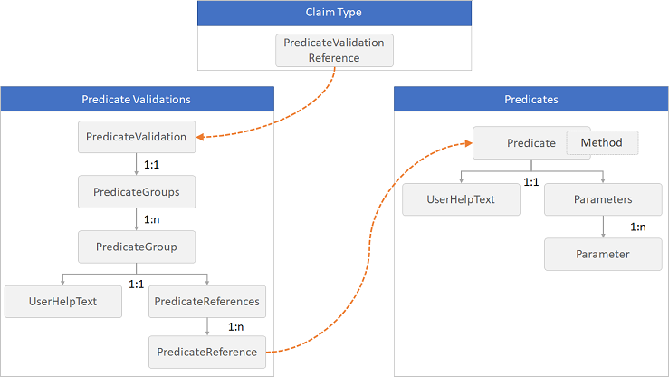
Predicates
Notes:
Predicates y PredicateValidations - Azure AD B2C | Microsoft Learn
El elemento Predicate define una validación básica para comprobar el valor de un tipo de notificación y devuelve true o false.
La validación se realiza mediante el uso de un elemento Method especificado y un conjunto de elementos Parameter
un predicado puede comprobar si la longitud de un valor de notificación de cadena está dentro del intervalo de parámetros mínimos y máximos especificados, o si un valor de notificación de cadena contiene un juego de caracteres. Si se produce un error en la comprobación, el elemento UserHelpText proporciona un mensaje de error para los usuarios.
El elemento Predicados debe aparecer directamente después del elemento ClaimsSchema en el elemento BuildingBlocks.

Slide 62
Element | Occurrences | Description
Predicate | 1:n | A list of predicates.
Attribute | Required | Description
Id | Yes | An identifier that's used for the predicate. Other elements can use this identifier in the policy.
Method | Yes | The method type to use for validation. Possible values: IsLengthRange, MatchesRegex, IncludesCharacters, or IsDateRange.
HelpText | No | An error message for users if the check fails.
Notes:
El elemento TrustFrameworkPolicy contiene los atributos siguientes:

Slide 63
IsLengthRange
<Predicate Id="IsLengthBetween8And64" Method="IsLengthRange" HelpText="The password must be between 8 and 64 characters.">
<Parameters>
<Parameter Id="Minimum">8</Parameter>
<Parameter Id="Maximum">64</Parameter>
</Parameters>
</Predicate>

Slide 64
MatchesRegex
<Predicate Id="PIN" Method="MatchesRegex" HelpText="The password must be numbers only.">
<Parameters>
<Parameter Id="RegularExpression">^[0-9]+$</Parameter>
</Parameters>
</Predicate>

Slide 65
IncludeCharacters
<Predicate Id="Lowercase" Method="IncludesCharacters" HelpText="a lowercase letter">
<Parameters>
<Parameter Id="CharacterSet">a-z</Parameter>
</Parameters>
</Predicate>

Slide 66
IsDateRange
<Predicate Id="DateRange" Method="IsDateRange" HelpText="The date must be between 1970-01-01 and today.">
<Parameters>
<Parameter Id="Minimum">1970-01-01</Parameter>
<Parameter Id="Maximum">Today</Parameter>
</Parameters>
</Predicate>

Slide 67
Predicate Validations
<PredicateValidations>
<PredicateValidation Id="">
<PredicateGroups>
<PredicateGroup Id="">
<UserHelpText></UserHelpText>
<PredicateReferences MatchAtLeast="">
<PredicateReference Id="" />
. . .
</PredicateReferences>
</PredicateGroup>
. . .
</PredicateGroups>
</PredicateValidation>
. . .
</PredicateValidations>
Notes:
Predicates y PredicateValidations - Azure AD B2C | Microsoft Learn
Mientras que los predicados definen la validación que se va a comparar con un tipo de notificación, PredicateValidations agrupa un conjunto de predicados para formar una validación de entrada de usuario que se puede aplicar a un tipo de notificación. Cada elemento PredicateValidation contiene un conjunto de elementos PredicateGroup que contienen un conjunto de elementos PredicateReference que dirigen a un elemento Predicate. Para pasar la validación, el valor de la notificación debe superar todas las pruebas de cualquier predicado en todo el PredicateGroup con su conjunto de elementos PredicateReference.
El elemento PredicateValidations debe aparecer directamente después del elemento Predicados en el elemento BuildingBlocks.

Slide 68
Demo Predicados
Notes:
Demo por cada tipo de method.
Disponible en ruta: Exercises\Day2\3 - Claims\DemoPredicates\DemoPredicates.xml

Slide 69
Ejercicio 3.
Notes:
Crear un flujo con las siguientes consideraciones:
1 - Referencia a Base
2 – Creación de una claim de tipo Country enumerado
3 – Creación de una claim de tipo fecha
4 – Creación de una claim de tipo contraseña
5 – Crear predicado que compruebe que la contraseña tenga entre 8 y 12 y que tenga mínimo una minúscula, una mayúscula, un número y un dígito.
6 – Crear un predicado que compruebe que la fecha sea mayor que hoy hasta final de año
Ejercicio resuelto en ruta: Exercises\Day2\3 - Claims\Exercise\Exercise.xml

Slide 70
Claims Transformations
<ClaimsTransformations>
<ClaimsTransformation Id="<identifier>" TransformationMethod="<method>">
<InputClaims>
. . .
</InputClaims>
<InputParameters>
. . .
</InputParameters>
<OutputClaims>
. . .
</OutputClaims>
</ClaimsTransformation>
Notes:
Una transformación de claims convierte una claims determinada en otra. En la transformación de claims, debe especificar el método de transformación, por ejemplo, agregando un elemento a una colección de cadenas o cambiando las mayúsculas y minúsculas de una cadena.
Identificador:
TransformationMethod: El método de transformación que se va a usar en la transformación de las reclamaciones. Cada transformación de notificación tiene sus propios valores.
ClaimsTransformations: Azure Active Directory B2C | Microsoft Learn

Slide 71
Input claim
Attribute | Required | Description
ClaimTypeReferenceId | Yes | A reference to a ClaimType already defined in the ClaimsSchema section in the policy.
TransformationClaimType | Yes | An identifier to reference a transformation claim type. Each claim transformation has its own values.
Attribute | Required | Description
Id | Yes | An identifier that is a reference to a parameter of the claims transformation method.
DataType | Yes | The type of data of the parameter.
Value | Yes | A value that is passed verbatim to the transformation.
Notes:
Referencias ClaimTYpe: Un identificador para hacer referencia a un tipo de notificación de transformación. Cada transformación de notificación tiene sus propios valores
InputClaim
InputParameter
OutputClaim
Referencias de tipos de trasnsformaciones
Boolean
Date
Entero
JSON
Número de teléfono
General
Cuenta social
String
StringCollection

Slide 72
Output claim
Attribute | Required | Description
ClaimTypeReferenceId | Yes | A reference to a ClaimType already defined in the ClaimsSchema section in the policy.
TransformationClaimType | Yes | An identifier to reference a transformation claim type. Each claim transformation has its own values.
Notes:
Referencias ClaimTYpe: Un identificador para hacer referencia a un tipo de notificación de transformación. Cada transformación de notificación tiene sus propios valores
InputClaim
InputParameter
OutputClaim
Referencias de tipos de trasnsformaciones
Boolean
Date
Entero
JSON
Número de teléfono
General
Cuenta social
String
StringCollection

Slide 73
Demo Claims Transformations
Notes:
Demo por cada tipo de method.
Disponibles en ruta: Exercises\Day2\4 - Claims Transformations\DemoClaimsTransformations

Slide 74
Ejercicio 4.
Notes:
Crear un flujo con las siguientes consideraciones:
1 - Referencia a Base
2 – Creación de una claim de tipo employeeId string
3 – Creación de una claim de tipo employeeIdNew string
4 – Creación de una claim de tipo termsOfUse checkbox
5 – Creación de una claim de tipo privacyPolicy checkbox
6 – Creación de una claim de tipo readAccountRules checkbox
7 – Creación de una claim de tipo isAgeOver21Years checkbox
8 – Creamos una transformación que compare claims (CompareClaims) entre employeeId y employeeIdNew
9 – Creamos una transformación que compare claims (AndClaims) entre termsOfUse y privacyPolicy
10 – Creamos una transformación para asertar que un claim es true (AssertBooleanClaimIsEqualToValue) readAccountRules
11 – Creamos una transformación para asertar que el claim isAgeOver21Years es true (CompareBooleanClaimToValue)
12 – Creamos una transformación para negar el claim isAgeOver21Years (NotClaims)
Disponible en ruta: Exercises\Day2\4 - Claims Transformations\Exercise\Exercise.xml

Slide 75
Content Definitions
<ContentDefinition Id="api.localaccountsignup">
<LoadUri>~/tenant/default/selfAsserted.cshtml</LoadUri>
<RecoveryUri>~/common/default_page_error.html</RecoveryUri>
<DataUri>urn:com:microsoft:aad:b2c:elements:selfasserted:1.1.0</DataUri>
<Metadata>
<Item Key="DisplayName">Local account sign up page</Item>
</Metadata>
<LocalizedResourcesReferences MergeBehavior="Prepend">
<LocalizedResourcesReference Language="en" LocalizedResourcesReferenceId="api.localaccountsignup.en" />
<LocalizedResourcesReference Language="es" LocalizedResourcesReferenceId="api.localaccountsignup.es" />
. . .
Notes:
El elemento ContentDefinitions contiene direcciones URL a plantillas HTML5 que pueden usarse en un recorrido del usuario.
El URI de la página HTML5 se usa para un paso especificado de la interfaz de usuario. Por ejemplo, páginas de error, de registro o inicio de sesión, o de restablecimiento de contraseña.
Los technical Profiles tienen un element de metadata que hacen referencia al ContentDefinitionReferenceId.

Slide 76
Element | Occurrences | Description
LoadUri | 1:1 | A string that contains the URL of the HTML5 page for the content definition.
RecoveryUri | 1:1 | A string that contains the URL of the HTML page for displaying an error relating to the content definition. Not currently used, the value must be ~/common/default_page_error.html.
DataUri | 1:1 | A string that contains the relative URL of an HTML file that provides the user experience to invoke for the step.
Metadata | 0:1 | A collection of key/value pairs that contains the metadata utilized by the content definition.
LocalizedResourcesReferences | 0:1 | A collection of localized resources references. Used to customize the localization of a user interface and claims attribute.
Notes:
LoadUri
Los que empiezan por ~ hacen referencia a un path relativo del propio tenant de Azure B2C
Se puede customiuzar añadiendo cualquier path absoluto, De un Storage por ejemplo. https://your-storage-account.blob.core.windows.net/your-container/customize-ui.html
DataUri
Cargar Ht,l y javascript del lado cliente. lista de los identificadores de página que puede usar.
urn:com:microsoft:aad:b2c:elements:page-name:version
Globalexception: Muestra una página de error cuando se produce una excepción o un error.
providerselection, idpselection: Muestra una lista de los proveedores de identidades que los usuarios pueden elegir durante el inicio de sesión.
Unifiedssp: Muestra un formulario para iniciar sesión con una cuenta local basada en una dirección de correo electrónico o un nombre de usuario. Este valor también proporciona la "funcionalidad de mantener iniciada la sesión" y el vínculo "¿Olvidó la contraseña?".
Unifiedssd: Muestra un formulario para iniciar sesión con una cuenta local basada en una dirección de correo electrónico o un nombre de usuario. Este identificador de página está en desuso. Use el identificador de página unifiedssp en su lugar.
Multifactor: Verifica los números de teléfono mediante mensajes de texto o llamadas de voz durante el registro o inicio de sesión.
Selfasserted: Muestra un formulario para recopilar datos de un usuario. Por ejemplo, permite a los usuarios crear o actualizar su perfil.
Puede habilitar el código cliente de JavaScript insertando contract entre elements y el tipo de página. Por ejemplo, urn:com:microsoft:aad:b2c:elements:contract:page-name:version.
Claves de metadatos
DisplayName Obligatorio:No Una cadena que contiene el nombre de la definición del contenido.
Id. de definición de contenido
En la tabla siguiente… todos los tipos. Puede crear sus propias definiciones de contenido con un id. arbitrario.
ContentDefinitions - Azure AD B2C | Microsoft Learn

Slide 77
Demo Content Definitions
Notes:
Demo completa del content definition.
Ruta: Exercises/Day2/5 - ContentDefinitions/DemoContentDefinitions

Slide 78
Ejercicio 5.
Notes:
Crear un flujo con las siguientes consideraciones:
1 - Referencia a Base
2 – Cambiar un diseño de flujo localaccountsignup con el tuyo referenciado.
Ruta: Exercises/Day2/5 - ContentDefinitions/Exercise

Slide 79
Localization
<Localization Enabled="true">
<SupportedLanguages DefaultLanguage="en" MergeBehavior="ReplaceAll">
<SupportedLanguage>en</SupportedLanguage>
<SupportedLanguage>es</SupportedLanguage>
</SupportedLanguages>
<LocalizedResources Id="api.localaccountsignup.en">
<LocalizedResources Id="api.localaccountsignup.es">
. . .
Notes:
El elemento Localization permite incluir varios idiomas o configuraciones regionales en la directiva para los recorridos del usuario. Admitir la localización en las directivas le permite:
Configurar la lista explícita de los idiomas admitidos en una directiva y seleccionar un idioma predeterminado.
Proporcionar cadenas y colecciones específicas del idioma.
Enabled: Obligatorio: No Valores True/False
SupportedLanguages 1:n Lista de idiomas admitidos.
LocalizedResources 0:n Lista de recursos localizados.

Slide 80
Attribute | Required | Description
ElementType | Yes | References a ClaimType element or a user interface element in the policy file.
ElementId | Yes | A string that contains a reference to a claim type already defined in the ClaimsSchema section.
TargetCollection | Yes | The target collection.
Attribute | Required | Description
Text | Yes | The user-friendly display string that should be shown to the user in the user interface for this option.
Value | Yes | The string claim value associated with selecting this option.
SelectByDefault | No | Indicates whether or not this option should be selected by default in the UI. Possible values: True or False.
Notes:
LozalizedCollections:
LocalizedCollection - 1:n -Lista de idiomas admitidos.

Slide 81
Lozalized Collections
<LocalizedResources Id="api.selfasserted.en">
<LocalizedCollections>
<LocalizedCollection ElementType="ClaimType" ElementId="Gender" TargetCollection="Restriction">
<Item Text="Female" Value="F" />
<Item Text="Male" Value="M" />
</LocalizedCollection>
</LocalizedCollections>
</LocalizedResources>
<LocalizedResources Id="api.selfasserted.es">
<LocalizedCollections>
<LocalizedCollection ElementType="ClaimType" ElementId="Gender" TargetCollection="Restriction">
<Item Text="Femenino" Value="F" />
<Item Text="Masculino" Value="M" />
</LocalizedCollection>
</LocalizedCollections>
</LocalizedResources>

Slide 82
Attribute | Required | Description
ElementType | Yes | Possible values: ClaimsProvider, ClaimType, ErrorMessage, GetLocalizedStringsTransformationClaimType, FormatLocalizedStringTransformationClaimType, Predicate, PredicateValidation, or UxElement.
ElementId | Yes | If ElementType is set to ClaimType, Predicate, or PredicateValidation, this element contains a reference to a claim type already defined in the ClaimsSchema section.
StringId | Yes | If ElementType is set to ClaimType, this element contains a reference to an attribute of a claim type. If ElementType is set to UxElement, this element contains a reference to an attribute of a user interface element. If ElementType is set to ErrorMessage, this element specifies the identifier of an error message.
Notes:
LocalizedStrings :
LocalizedStrings - 1:n -Cadena localizada.
StringIf ElementType Valores posibles: El valor DisplayName se usa para establecer el nombre para mostrar de la notificación. El valor AdminHelpText se usa para establecer el nombre del texto de ayuda del usuario de la notificación. El valor PatternHelpText se usa para establecer el texto de ayuda del patrón de la notificación
Mostramos ejemplos en la demo.

Slide 83
Lozalized Strings
<LocalizedResources Id="api.phonefactor.en">
<LocalizedStrings>
<LocalizedString ElementType="UxElement" StringId="button_verify">Call Me</LocalizedString>
</LocalizedStrings>
</LocalizedResources>
<LocalizedResources Id="api.phonefactor.es">
<LocalizedStrings>
<LocalizedString ElementType="UxElement" StringId="button_verify">Llamame</LocalizedString>
</LocalizedStrings>
</LocalizedResources>
Notes:
El elemento Localization permite incluir varios idiomas o configuraciones regionales en la directiva para los recorridos del usuario. Admitir la localización en las directivas le permite:
Configurar la lista explícita de los idiomas admitidos en una directiva y seleccionar un idioma predeterminado.
Proporcionar cadenas y colecciones específicas del idioma.
Enabled: Obligatorio: No Valores True/False
SupportedLanguages 1:n Lista de idiomas admitidos.
LocalizedResources 0:n Lista de recursos localizados.

Slide 84
Demo Localizations
Notes:
Demo por cada tipo de lozalization.
Ruta: Exercises\Day2\6 - Localizations\DemoLocalizations
Conveniente seguir: https://learn.microsoft.com/en-us/azure/active-directory-b2c/language-customization?pivots=b2c-custom-policy

Slide 85
Ejercicio 6.
Notes:
Crear un flujo con las siguientes consideraciones:
- Proporcionar soporte para inglés y español.
- Proporcionar texto localizado para cada valor del combo de género, además de el propio título del campo.
- Cambiar el texto del botón de continuar (hint: el id es `button_continue`) a algo distinto para ambos idiomas.
- Cambiar el mensaje de error que se produce si el email ya existe (hint: el id es `UserMessageIfClaimsPrincipalAlreadyExists`) a algo distinto para ambos idiomas.
De esta manera seremos capaces de aprender como localizar varios elementos de la interfaz de usuario.
Ejercicio resuelto en: Exercises\Day2\6 - Localizations\Exercise\Exercise.xml

Slide 86
Display Controls
<DisplayControl Id="emailVerificationControl" UserInterfaceControlType="VerificationControl">
<InputClaims></InputClaims>
<DisplayClaims>
<DisplayClaim ClaimTypeReferenceId="email" Required="true" />
<DisplayClaim ClaimTypeReferenceId="verificationCode" ControlClaimType="VerificationCode" Required="true" />
</DisplayClaims>
<OutputClaims></OutputClaims>
<Actions>
<Action Id="SendCode">
<ValidationClaimsExchange>
<ValidationClaimsExchangeTechnicalProfile TechnicalProfileReferenceId="AadSspr-SendCode"/>
</ValidationClaimsExchange>
</Action>
<Action Id="VerifyCode">
<ValidationClaimsExchange>
<ValidationClaimsExchangeTechnicalProfile TechnicalProfileReferenceId="AadSspr-VerifyCode"/>
</ValidationClaimsExchange>
</Action>
</Actions>
</DisplayControl>
Notes:
Un display control es un elemento de la interfaz de usuario que tiene una funcionalidad especial e interactúa con el servicio en el entorno back-end de Azure Active Directory B2C (Azure AD B2C). Permite al usuario realizar acciones en la página que invocan un validation technical profile en el entorno back-end. Los controles de visualización se muestran en la página y se hace referencia a ellos mediante un self-asserted technical profile.
The DisplayControl element contains the following attributes:
Id AND UserInterfaceControlType: The type of the display control. Currently supported is VerificationControl, and TOTP controls. Use time-based one-time password (TOTP)
The verification display control verifies claims, for example an email address or phone number, with a verification code sent to the user.
The TOTP display controls are a set of display controls that provide TOTP multifactor authentication with the Microsoft Authenticator app.

Slide 87
Element | Occurrences | Description
InputClaims | 0:1 | InputClaims are used to prepopulate the value of the claims to be collected from the user.
DisplayClaims | 0:1 | DisplayClaims are used to represent claims to be collected from the user.
OutputClaims | 0:1 | OutputClaims are used to represent claims to be saved temporarily for this DisplayControl
Actions | 0:1 | Actions are used to list the validation technical profiles to invoke for user actions happening at the front end.
Notes:
LoadUri
Los que empiezan por ~ hacen referencia a un path relativo del propio tenant de Azure B2C
Se puede customiuzar añadiendo cualquier path absoluto, De un Storage por ejemplo. https://your-storage-account.blob.core.windows.net/your-container/customize-ui.html
DataUri
Cargar Ht,l y javascript del lado cliente. lista de los identificadores de página que puede usar.
urn:com:microsoft:aad:b2c:elements:page-name:version
Globalexception: Muestra una página de error cuando se produce una excepción o un error.
providerselection, idpselection: Muestra una lista de los proveedores de identidades que los usuarios pueden elegir durante el inicio de sesión.
Unifiedssp: Muestra un formulario para iniciar sesión con una cuenta local basada en una dirección de correo electrónico o un nombre de usuario. Este valor también proporciona la "funcionalidad de mantener iniciada la sesión" y el vínculo "¿Olvidó la contraseña?".
Unifiedssd: Muestra un formulario para iniciar sesión con una cuenta local basada en una dirección de correo electrónico o un nombre de usuario. Este identificador de página está en desuso. Use el identificador de página unifiedssp en su lugar.
Multifactor: Verifica los números de teléfono mediante mensajes de texto o llamadas de voz durante el registro o inicio de sesión.
Selfasserted: Muestra un formulario para recopilar datos de un usuario. Por ejemplo, permite a los usuarios crear o actualizar su perfil.
Puede habilitar el código cliente de JavaScript insertando contract entre elements y el tipo de página. Por ejemplo, urn:com:microsoft:aad:b2c:elements:contract:page-name:version.
Claves de metadatos
DisplayName Obligatorio:No Una cadena que contiene el nombre de la definición del contenido.
Id. de definición de contenido
En la tabla siguiente… todos los tipos. Puede crear sus propias definiciones de contenido con un id. arbitrario.
ContentDefinitions - Azure AD B2C | Microsoft Learn

Slide 88
Demo Display Controls
Notes:
Demo Verification control – Base: https://learn.microsoft.com/en-us/azure/active-directory-b2c/display-controls
Flujo de verificación para cambiar contraseña con verificación OTP vía emailExercises\Day2\7 - Display Controls\DemoDisplayControls\DemoDisplayControls.xml

Slide 89
Ejercicio 7.
Notes:
Crear un flujo con las siguientes consideraciones:
1 – Crear un flujo de Display Controls para resetear una contraseña basándonos en un OTP.
Ejercicio resuelto (igual a la demo): Exercises\Day2\7 - Display Controls\Exercise\Exercise.xml

Slide 90
Claims Providers
Claims Providers
Technical Profiles

Slide 91
Claims Providers
<ClaimsProviders>
<ClaimsProvider>
<Domain>Domain name</Domain>
<DisplayName>Display name</DisplayName>
<TechnicalProfiles>
</TechnicalProfile>
...
</TechnicalProfile>
...
</TechnicalProfiles>
</ClaimsProvider>
...
</ClaimsProviders>
Notes:
El elemento ClaimsProviders contiene el elemento siguiente:
ClaimsProvider 1:n Proveedor de notificaciones acreditado que se puede utilizar en varios recorridos de usuario.
Domain 0:1 Cadena que contiene el nombre de dominio del proveedor de notificaciones. Por ejemplo, si el proveedor de notificaciones incluye el perfil técnico de Facebook, el nombre de dominio será Facebook.com.
DisplayName 1:1 Una cadena que contiene el nombre del proveedor de notificaciones.
TechnicalProfiles0:1Conjunto de perfiles técnicos admitidos por el proveedor de notificaciones.
<DisplayName>Azure Active Directory</DisplayName>
<TechnicalProfile Id="AAD-Common">
<TechnicalProfile Id="AAD-UserWriteUsingAlternativeSecurityId">
<TechnicalProfile Id="AAD-UserReadUsingAlternativeSecurityId">
<TechnicalProfile Id="AAD-UserReadUsingAlternativeSecurityId-NoError">
<TechnicalProfile Id="AAD-UserReadUsingEmailAddress">
<TechnicalProfile Id="AAD-UserWritePasswordUsingObjectId">
<TechnicalProfile Id="AAD-UserWriteProfileUsingObjectId">
<TechnicalProfile Id="AAD-UserReadUsingObjectId">
<TechnicalProfile Id="AAD-UserWritePhoneNumberUsingObjectId">

Slide 92
Technical Profiles
Tipos
Application Insights: Envía datos a Application Insights.
Azure AD, Compatibilidad con administración de usuarios de Azure AD B2C.
Azure AD multifactor authentication, Compatibilidad para verificar números de teléfono mediante MFA Azure AD.
Claims transformations, Transformaciones de OutpuClaims para manipular los valores, validar o establecer valores predeterminados.
ID token hint, Validacíón de token de JWT.
JWT token issuer, Envío de token de JWT.
OAuth1, OAuth2, Federación con proveedores de identidad Oauth 1.0 y 2.0.
One-time password, Administar la generación y verificación de contraseñas de un solo uso.
OpenID Connect, Federación con proveedores de identidad OpenID Connect.
Phone factor, Compatibilidad de inscripción y verificación de números de teléfono.
RESTful Provider, Llamada a servicios API REST.
Self-asserted, Interacciones con el usuario
Session management, Administración de la sesión-.
SAML identity provider, Federación y emission de tokens de identidad con SAML.
Notes:
Un perfil técnico proporciona un marco con un mecanismo integrado para comunicarse con distintos tipos de partes. Los perfiles técnicos se usan para comunicarse con su inquilino de Azure Active Directory B2C (Azure AD B2C) a fin de crear un usuario o leer un perfil de usuario. Un perfil técnico puede ser autoafirmado para habilitar la interacción con el usuario. Por ejemplo, un perfil técnico puede recopilar las credenciales del usuario para iniciar sesión y, a continuación, representar la página de registro o de restablecimiento de contraseña.

Slide 93
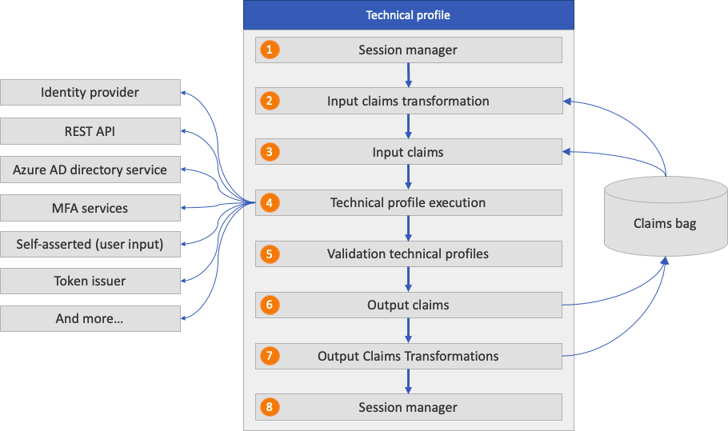
Notes:
Administración de la sesión de inicio de sesión único (SSO) : restaura el estado de sesión del perfil técnico mediante la administración de la sesión de inicio de sesión único.
Transformación de notificaciones de entrada: antes de iniciarse el perfil técnico, Azure AD B2C ejecuta la entrada de transformación de notificaciones.
Notificaciones de entrada: las notificaciones se toman del contenedor de notificaciones y se usan para el perfil técnico.
Ejecución de perfil técnico: el perfil técnico intercambia las notificaciones con la parte configurada. Por ejemplo:
Redirige el usuario al proveedor de identidades para completar el inicio de sesión. Después de iniciar sesión correctamente, el usuario regresa y la ejecución del perfil técnico continúa.
Llama a una API REST mientras envía parámetros como InputClaims y recupera información como OutputClaims.
Crea o actualiza los usuarios la cuenta de usuario.
Envía y verifica el mensaje de texto de autenticación multifactor.
Perfiles técnicos de validación: un perfil técnico autoafirmado puede llamar a perfiles técnicos de validación para validar los datos generados por el usuario.
Notificaciones de salida: las notificaciones se devuelven al contenedor de notificaciones. Puede usar esas notificaciones en el siguiente paso de orquestaciones o generar transformaciones de notificaciones.
Transformaciones de notificaciones de salida: una vez completado el perfil técnico, Azure AD B2C ejecuta las transformaciones de notificaciones de salida.
Administración de la sesión de SSO: conserva los datos del perfil técnico en la sesión mediante la administración de la sesión de SSO.

Slide 94
Technical Profiles
<ClaimsProvider>
<DisplayName>Display name</DisplayName>
<TechnicalProfiles>
<TechnicalProfile Id="Technical profile identifier">
<DisplayName>Display name of technical profile</DisplayName>
<Protocol Name="Proprietary" Handler="Web.TPEngine.Providers.RestfulProvider, Web.TPEngine, Version=1.0.0.0, Culture=neutral, PublicKeyToken=null" />
<Metadata>
...
</Metadata>
...
</TechnicalProfile>
</TechnicalProfiles>
</ClaimsProvider>

Slide 95
Elemento | Repeticiones | Descripción
Domain | 0:1 | Nombre de dominio del perfil técnico.
DisplayName | 1:1 | Nombre para mostrar del perfil técnico.
Descripción | 0:1 | Descripción del perfil técnico.
Protocolo | 1:1 | Protocolo usado para la comunicación con la otra parte.
Metadatos | 0:1 | Conjunto de claves y valores que controla el comportamiento del perfil técnico.
InputTokenFormat | 0:1 | Formato del token de entrada.
OutputTokenFormat | 0:1 | Formato del token de salida
CryptographicKeys | 0:1 | Lista de claves criptográficas que se usan en el perfil técnico.
InputClaimsTransformations | 0:1 | Lista de referencias a ClaimsTransformations que tienen que ejecutarse antes de enviar claims provider o relying party.
InputClaims | 0:1 | Lista de referencias a claim types que se usan como entrada en el perfil técnico.
Notes:
Formato del token de entrada. Los valores posibles son JSON, JWT, SAML11 o SAML2

Slide 96
Elemento | Repeticiones | Descripción
PersistedClaims | 0:1 | Lista de referencias a claim types que persisten.
DisplayClaims | 0:1 | Lista de referencias a claim types que se visualizan.
OutputClaims | 0:1 | Lista de referencias a claim types que se usan como salida.
OutputClaimsTransformations | 0:1 | Referencias a ClaimsTransformations que van a usarse.
ValidationTechnicalProfiles | 0:n | Referencias a Validaciones que se ejecutan.
SubjectNamingInfo | 0:1 | Control del Subject Name en los tokens.
IncludeInSso | 0:1 | Indica si debe aplicar SSO o una interacción explícita.
IncludeClaimsFromTechnicalProfile | 0:1 | Identificador de TechnicalProfile para incluir las claims de entrada o salida.
IncludeTechnicalProfile | 0:1 | Identificador de TechnicalProfile cuyos datos quiere agregar a este perfil técnico.
UseTechnicalProfileForSessionManagement | 0:1 | Perfil técnico que se usará para la administración de sesiones.
EnabledForUserJourneys | 0:1 | Controla si el perfil técnico se ejecuta en una User Journey

Slide 97
Protocol
Atributo | Obligatorio | Descripción
Name | Sí | Nombre de un protocolo válido admitido por Azure AD B2C que se usará como parte del perfil técnico. Los valores posibles son OAuth1, OAuth2, SAML2, OpenIdConnect, Proprietary o None.
Handler | No | Cuando el nombre del protocolo se establece en Proprietary, especifica el nombre del ensamblado que usará Azure AD B2C para determinar el controlador de protocolo.

Slide 98
Metadata
<TechnicalProfile Id="Facebook-OAUTH">
...
<Metadata>
<Item Key="ProviderName">facebook</Item>
<Item Key="authorization_endpoint">https://www.facebook.com/dialog/oauth</Item>
<Item Key="AccessTokenEndpoint">https://graph.facebook.com/oauth/access_token</Item>
<Item Key="HttpBinding">GET</Item>
<Item Key="UsePolicyInRedirectUri">0</Item>
...
</Metadata>
...
</TechnicalProfile>

Slide 99
Cryptographic keys
<TechnicalProfiles>
<TechnicalProfile Id="JwtIssuer">
...
<CryptographicKeys>
<Key Id="issuer_secret" StorageReferenceId="B2C_1A_TokenSigningKeyContainer" />
<Key Id="issuer_refresh_token_key" StorageReferenceId="B2C_1A_TokenEncryptionKeyContainer" />
</CryptographicKeys>
</TechnicalProfile>
</TechnicalProfiles>
Notes:
Para establecer la confianza con los servicios con los que se integra, Azure AD B2C almacena secretos y certificados en forma de claves de directiva. Durante la ejecución del perfil técnico, Azure AD B2C recupera las claves criptográficas de las claves de directiva de Azure AD B2C. A continuación, las usa para establecer la confianza, cifrar o firmar un token. Estas confianzas constan de los siguientes componentes:
Federación con los proveedores de identidades OAuth1, OAuth2 y SAML
Protección de la conexión con los servicios de la API REST
Firma y cifrado de los tokens JWT y SAML

Slide 100
InputClaimsTransformation
<TechnicalProfile Id="AAD-UserWriteUsingAlternativeSecurityId">
...
<InputClaimsTransformations>
<InputClaimsTransformation ReferenceId="CreateOtherMailsFromEmail" />
</InputClaimsTransformations>
<PersistedClaims>
<PersistedClaim ClaimTypeReferenceId="alternativeSecurityId" />
<PersistedClaim ClaimTypeReferenceId="userPrincipalName" />
<PersistedClaim ClaimTypeReferenceId="mailNickName" DefaultValue="unknown" />
<PersistedClaim ClaimTypeReferenceId="displayName" DefaultValue="unknown" />
<PersistedClaim ClaimTypeReferenceId="otherMails" />
<PersistedClaim ClaimTypeReferenceId="givenName" />
<PersistedClaim ClaimTypeReferenceId="surname" />
</PersistedClaims>
...
</TechnicalProfile>
Notes:
Los siguientes perfiles técnicos hacen referencia a la transformación de notificaciones CreateOtherMailsFromEmail. La transformación de notificaciones agrega el valor de la notificación email a la colección otherMails antes de conservar los datos en el directorio.

Slide 101
InputClaims
<TechnicalProfiles>
<TechnicalProfile Id="login-NonInteractive">
...
<InputClaims>
<InputClaim ClaimTypeReferenceId="signInName" PartnerClaimType="username" Required="true" />
<InputClaim ClaimTypeReferenceId="password" Required="true" />
<InputClaim ClaimTypeReferenceId="grant_type" DefaultValue="password" AlwaysUseDefaultValue="true" />
<InputClaim ClaimTypeReferenceId="scope" DefaultValue="openid" AlwaysUseDefaultValue="true" />
<InputClaim ClaimTypeReferenceId="nca" PartnerClaimType="nca" DefaultValue="1" />
</InputClaims>
<OutputClaims>
<OutputClaim ClaimTypeReferenceId="objectId" PartnerClaimType="oid" />
<OutputClaim ClaimTypeReferenceId="tenantId" PartnerClaimType="tid" />
</OutputClaims>
</TechnicalProfile>
</TechnicalProfiles>

Slide 102
DisplayClaims
<TechnicalProfile Id="Id">
<DisplayClaims>
<DisplayClaim DisplayControlReferenceId="emailVerificationControl" />
<DisplayClaim ClaimTypeReferenceId="displayName" Required="true" />
<DisplayClaim ClaimTypeReferenceId="givenName" Required="true" />
<DisplayClaim ClaimTypeReferenceId="surName" Required="true" />
<DisplayClaim DisplayControlReferenceId="phoneVerificationControl" />
<DisplayClaim ClaimTypeReferenceId="newPassword" Required="true" />
<DisplayClaim ClaimTypeReferenceId="reenterPassword" Required="true" />
</DisplayClaims>
</TechnicalProfile>

Slide 103
PersistedClaims
<TechnicalProfile Id="JwtIssuer">
<PersistedClaims>
<PersistedClaim ClaimTypeReferenceId="email" PartnerClaimType="signInNames.emailAddress" />
<PersistedClaim ClaimTypeReferenceId="newPassword" PartnerClaimType="password"/>
<PersistedClaim ClaimTypeReferenceId="displayName" DefaultValue="unknown" />
<PersistedClaim ClaimTypeReferenceId="passwordPolicies" DefaultValue="DisablePasswordExpiration" />
<PersistedClaim ClaimTypeReferenceId="givenName" />
<PersistedClaim ClaimTypeReferenceId="surname" />
</PersistedClaims>
</TechnicalProfile>

Slide 104
OutputClaimsTransformations
<TechnicalProfile Id="AAD-UserReadUsingEmailAddress">
...
<OutputClaims>
<OutputClaim ClaimTypeReferenceId="objectId" />
<OutputClaim ClaimTypeReferenceId="authenticationSource" DefaultValue="localAccountAuthentication" />
<OutputClaim ClaimTypeReferenceId="userPrincipalName" />
<OutputClaim ClaimTypeReferenceId="displayName" />
<OutputClaim ClaimTypeReferenceId="accountEnabled" />
<OutputClaim ClaimTypeReferenceId="otherMails" />
<OutputClaim ClaimTypeReferenceId="signInNames.emailAddress" />
</OutputClaims>
<OutputClaimsTransformations>
<OutputClaimsTransformation ReferenceId="AssertAccountEnabledIsTrue" />
</OutputClaimsTransformations>
...
</TechnicalProfile>

Slide 105
Validation Techical Profiles
<ValidationTechnicalProfile ReferenceId="login-NonInteractive" ContinueOnError="false" />
<ValidationTechnicalProfile ReferenceId="REST-ReadProfileFromCustomersDatabase" ContinueOnError="true" >
<Preconditions>
<Precondition Type="ClaimsExist" ExecuteActionsIf="false">
<Value>userType</Value>
<Action>SkipThisValidationTechnicalProfile</Action>
</Precondition>
<Precondition Type="ClaimEquals" ExecuteActionsIf="true">
<Value>userType</Value>
<Value>Partner</Value>
<Action>SkipThisValidationTechnicalProfile</Action>
</Precondition>
</Preconditions>
</ValidationTechnicalProfile>
Notes:
<!-- Optional claims. These claims are collected from the user and can be modified. Any claim added here should be updated in the
ValidationTechnicalProfile referenced below so it can be written to directory after being updated by the user, i.e. AAD-UserWriteProfileUsingObjectId. -->

Slide 106
Include Techical Profiles
<TechnicalProfile Id="SelfAsserted-ProfileUpdate">
...
<InputClaims>
<InputClaim ClaimTypeReferenceId="givenName" />
<InputClaim ClaimTypeReferenceId="surname" />
</InputClaims>
<OutputClaims>
<OutputClaim ClaimTypeReferenceId="givenName" />
<OutputClaim ClaimTypeReferenceId="surname" />
</OutputClaims>
<IncludeTechnicalProfile ReferenceId="REST-API-Common" />
</TechnicalProfile>
</TechnicalProfiles>

Slide 107
Multilevel Techical Profiles
<TechnicalProfile Id="AAD-UserReadUsingAlternativeSecurityId-NoError">
<Metadata>
<Item Key="RaiseErrorIfClaimsPrincipalDoesNotExist">false</Item>
</Metadata>
<IncludeTechnicalProfile ReferenceId="AAD-UserReadUsingAlternativeSecurityId" />
</TechnicalProfile>
<TechnicalProfile Id="AAD-UserReadUsingAlternativeSecurityId">
<Metadata>
<Item Key="Operation">Read</Item>
<Item Key="RaiseErrorIfClaimsPrincipalDoesNotExist">true</Item>
</Metadata>
<IncludeTechnicalProfile ReferenceId="AAD-Common" />
</TechnicalProfile>

Slide 108
Enabled for user journeys
<TechnicalProfile Id="UnLink-Facebook-OAUTH">
<DisplayName>Unlink Facebook</DisplayName>
...
<Metadata>
<Item Key="ClaimTypeOnWhichToEnable">identityProviders</Item>
<Item Key="ClaimValueOnWhichToEnable">facebook.com</Item>
</Metadata>
...
<EnabledForUserJourneys>OnItemExistenceInStringCollectionClaim</EnabledForUserJourneys>
</TechnicalProfile>
Notes:
Con el elemento EnabledForUserJourneys, puede filtrar los proveedores de notificaciones que estarán disponibles para el usuario. El elemento EnabledForUserJourneys contiene uno de los valores siguientes:
Always: ejecuta el perfil técnico.
Never: omite el perfil técnico.
OnClaimsExistence: solo se ejecuta cuando existe una notificación específica indicada en el perfil técnico.
OnItemExistenceInStringCollectionClaim: solo se ejecuta cuando existe un elemento en una notificación de colección de cadenas.
OnItemAbsenceInStringCollectionClaim: solo se ejecuta cuando no existe ningún elemento en una notificación de colección de cadenas.
Para usar OnClaimsExistence, OnItemExistenceInStringCollectionClaim o OnItemAbsenceInStringCollectionClaim, es necesario que proporcione los siguientes metadatos:
ClaimTypeOnWhichToEnable: especifica el tipo de notificación que se va a evaluar.
ClaimValueOnWhichToEnable: especifica el valor que se va a comparar.

Slide 109
Azure AD Technical Profiles
<TechnicalProfile Id="AAD-UserReadUsingObjectId">
<Metadata>
<Item Key="Operation">Read</Item>
<Item Key="RaiseErrorIfClaimsPrincipalDoesNotExist">true</Item>
</Metadata>
<IncludeInSso>false</IncludeInSso>
<InputClaims>
<InputClaim ClaimTypeReferenceId="objectId" Required="true" />
</InputClaims>
<OutputClaims>
<OutputClaim ClaimTypeReferenceId="strongAuthenticationPhoneNumber" />
<OutputClaim ClaimTypeReferenceId="signInNames.emailAddress" />
<OutputClaim ClaimTypeReferenceId="displayName" />
<OutputClaim ClaimTypeReferenceId="otherMails" />
<OutputClaim ClaimTypeReferenceId="givenName" />
<OutputClaim ClaimTypeReferenceId="surname" />
</OutputClaims>
<IncludeTechnicalProfile ReferenceId="AAD-Common" />
</TechnicalProfile>
Notes:
El atributo Name del elemento Protocol tiene que establecerse en Proprietary. El atributo handler debe contener el nombre completo del ensamblado de controlador de protocolo Web.TPEngine.Providers.AzureActiveDirectoryProvider, Web.TPEngine, Version=1.0.0.0, Culture=neutral, PublicKeyToken=null.
los perfiles técnicos de Azure AD incluyen el perfil técnico AAD-Common. Los perfiles técnicos de Azure AD no especifican el protocolo porque este está configurado en el perfil técnico AAD-Common:
AAD-UserReadUsingAlternativeSecurityId y AAD-UserReadUsingAlternativeSecurityId-NoError: buscar una cuenta de redes sociales en el directorio.
AAD-UserWriteUsingAlternativeSecurityId: crear una cuenta de redes sociales.
AAD-UserReadUsingEmailAddress: buscar una cuenta local en el directorio.
AAD-UserWriteUsingLogonEmail: crear una cuenta local.
AAD-UserWritePasswordUsingObjectId: actualizar una contraseña de una cuenta local.
AAD-UserWriteProfileUsingObjectId: actualizar un perfil de usuario de una cuenta local o social.
AAD-UserReadUsingObjectId: leer un perfil de usuario de una cuenta local o social.
AAD-UserWritePhoneNumberUsingObjectId: escribir el número de teléfono de MFA de una cuenta local o socia

Slide 110
Demo Technical Profiles
Notes:
Enseñar AAD technical profiles
Enseñar esto Definición de un perfil técnico de la transformación de notificaciones - Azure AD B2C | Microsoft Learn Transformación de claims
Enseñar un Téchnical profile de tipo REST
Enseñar uno de SelfAsserted
Enseñar un proceso de MFA de Sengrid

Slide 111
Ejercicio 8.
Notes:
Crear un flujo con las siguientes consideraciones:
1 – Crear Tecnical Profile que valide si el DNI está registrado
2 – Si es así proceder al WRITE en AAD con esa claim nueva
3 – Si no es así raise error.

Slide 112
User Journeys
User Journeys
Sub Journeys

Slide 113
User Journey – Orchestration Steps
<UserJourney Id="SignUpOrSignIn">
<OrchestrationSteps>
<OrchestrationStep Order="1" Type="CombinedSignInAndSignUp" ContentDefinitionReferenceId="api.signuporsignin">
...
Notes:
El recorrido del usuario se representa como una secuencia de orquestación por la que hay que pasar para lograr una transacción correcta. Si se produce un error en algún paso, la transacción no prospera
Order: Required: The order of the orchestration steps.
Type: Required:
ClaimsProviderSelection: indica que el paso de orquestación presenta diversos proveedores de notificaciones al usuario para que seleccione uno.
CombinedSignInAndSignUp: indica que el paso de orquestación presenta una página combinada de inicio de sesión en el proveedor social y de registro en la cuenta local.
ClaimsExchange: indica que el paso de orquestación intercambia notificaciones con un proveedor de notificaciones.
GetClaims: especifica que el paso de orquestación debe procesar los datos de notificaciones enviados a Azure AD B2C del usuario de confianza mediante su configuración InputClaims.
InvokeSubJourney: indica que el paso de orquestación intercambia claims con una SubJourney
SendClaims: indica que el paso de orquestación envía las claims al usuario de confianza con un token emitido por un emisor de claims.
ContentDefinitionReferenceId: El identificador de la definición de contenido asociada a este paso de orquestación. Normalmente se define en el technical profile. Pero hay casos donde hay que especificarlo: ClaimsProviderSelection o CombinedSignInAndSignUp, Azure AD B2C debe mostrar la selección del proveedor de identidades sin tener ningún perfil técnico.
CpimIssuerTechnicalProfileReferenceId: El tipo de paso de orquestación es SendClaims. Esta propiedad define el identificador de perfil técnico del proveedor de notificaciones que emite el token del usuario de confianza. Si no aparece, no se crea ningún token para el usuario de confianza.

Slide 114
User Journey - Authorization
<UserJourney Id="UserInfoJourney" DefaultCpimIssuerTechnicalProfileReferenceId="UserInfoIssuer">
<Authorization>
<AuthorizationTechnicalProfiles>
<AuthorizationTechnicalProfile ReferenceId="UserInfoAuthorization" />
</AuthorizationTechnicalProfiles>
</Authorization>
<OrchestrationSteps>
<OrchestrationStep Order="1" Type="ClaimsExchange">
...
Notes:
Para comenzar este proceso, el usuario debe presentar el token de acceso emitido anteriormente como prueba de que se autenticó originalmente mediante una directiva de Azure AD B2C válida.
En el ejemplo siguiente se muestra un elemento de recorrido del usuario con perfiles técnicos de autorización:
ReferenceId: identificador del perfil técnico que se va a ejecutar.

Slide 115
User Journey – Orchestation Steps
<UserJourney Id="UserInfoJourney" DefaultCpimIssuerTechnicalProfileReferenceId="UserInfoIssuer">
<OrchestrationSteps>
<OrchestrationStep Order="4" Type="ClaimsExchange">
<Preconditions>
<Precondition Type="ClaimsExist" ExecuteActionsIf="true">
<Value>objectId</Value>
<Action>SkipThisOrchestrationStep</Action>
</Precondition>
<Precondition Type="ClaimEquals" ExecuteActionsIf="false">
<Value>MfaPreference</Value>
<Value>Phone</Value>
<Action>SkipThisOrchestrationStep</Action>
</Precondition>
</Preconditions>
<ClaimsExchanges>
<ClaimsExchange Id="SelfAsserted-SocialEmail" TechnicalProfileReferenceId="SelfAsserted-SocialEmail" />
</ClaimsExchanges>
</OrchestrationStep>
Notes:
Type: ClaimsExist, que especifica que se deben realizar las acciones si existen las notificaciones especificadas en el conjunto de notificaciones actual del usuario, o ClaimEquals, que especifica que las acciones deben realizarse si existe la notificación especificada y su valor es igual al valor especificado.
ExecuteActionsIf: true, se considera que se ha cumplido cuando la notificación coincide con la condición previa. Si el valor se establece en false, se considera que se ha cumplido cuando la notificación no coincide con la condición previa.
Value: La claim que ya se ha definido en la sección del esquema de claims del archivo de directiva o del archivo de directiva primario. Cuando la condición previa es de tipo ClaimEquals, un segundo elemento Value contiene el valor que se va a comprobar.
Action: Acción que se debe realizar si la se cumple la evaluación de la condición previa. Valor posible: SkipThisOrchestrationStep. El paso de orquestación asociado pasa al siguiente.

Slide 116
User Journey – Claims Providers
<OrchestrationStep Order="1" Type="CombinedSignInAndSignUp" ContentDefinitionReferenceId="api.signuporsignin">
<ClaimsProviderSelections>
<ClaimsProviderSelection TargetClaimsExchangeId="FacebookExchange" />
<ClaimsProviderSelection ValidationClaimsExchangeId="LocalAccountSigninEmailExchange" />
</ClaimsProviderSelections>
<ClaimsExchanges>
<ClaimsExchange Id="LocalAccountSigninEmailExchange"
TechnicalProfileReferenceId="SelfAsserted-LocalAccountSignin-Email" />
</ClaimsExchanges>
</OrchestrationStep>
<OrchestrationStep Order="2" Type="ClaimsExchange">
<Preconditions>
<Precondition Type="ClaimsExist" ExecuteActionsIf="true">
<Value>objectId</Value>
<Action>SkipThisOrchestrationStep</Action>
</Precondition>
</Preconditions>
<ClaimsExchanges>
<ClaimsExchange Id="FacebookExchange" TechnicalProfileReferenceId="Facebook-OAUTH" />
<ClaimsExchange Id="SignUpWithLogonEmailExchange" TechnicalProfileReferenceId="LocalAccountSignUpWithLogonEmail" />
Notes:
La selección del proveedor de identidades permite a los usuarios seleccionar una acción de una lista de opciones. La selección del proveedor de identidades consta de dos pasos de orquestación:
Botones: comienza con el tipo de ClaimsProviderSelection o CombinedSignInAndSignUp, que contiene una lista de opciones entre las que puede elegir un usuario. El orden de las opciones dentro del elemento ClaimsProviderSelections controla el orden de los botones de inicio de sesión que se presentan al usuario.
Acciones: seguido del tipo de ClaimsExchange. ClaimsExchange contiene una lista de acciones. La acción es una referencia a un perfil técnico, como OAuth2, OpenID Connect, transformación de notificaciones o autoafirmado. Cuando un usuario hace clic en uno de los botones, se ejecuta la acción correspondiente.
ClaimsProviderSelection: Proporciona la lista de proveedores de notificaciones que se pueden seleccionar.
DisplayOption: Required NO: Controla el comportamiento de un caso en el que solo hay disponible una selección del proveedor de notificaciones. DoNotShowSingleProvider el usuario se redirige inmediatamente al proveedor de identidades federadas. ShowSingleProviderAzure AD B2C presenta la página de inicio de sesión con la selección del proveedor de identidades única.
ClaimsExchanges: ejecuta con el intercambio de notificaciones seleccionado especificado en el atributo TargetClaimsExchangeId

Slide 117
Sub Journey - Call
<SubJourneys>
<SubJourney Id="ConditionalAccess_Evaluation" Type="Call">
<OrchestrationSteps>
<OrchestrationStep Order="1" Type="ClaimsExchange">
<ClaimsExchanges>
<ClaimsExchange Id="ConditionalAccessEvaluation" TechnicalProfileReferenceId="ConditionalAccessEvaluation" />
</ClaimsExchanges>
</OrchestrationStep>
<OrchestrationStep Order="2" Type="ClaimsExchange">
<Preconditions>
<Precondition Type="ClaimsExist" ExecuteActionsIf="false">
<Value>conditionalAccessClaimCollection</Value>
<Action>SkipThisOrchestrationStep</Action>
</Precondition>
</Preconditions>
<ClaimsExchanges>
<ClaimsExchange Id="GenerateCAClaimFlags" TechnicalProfileReferenceId="GenerateCAClaimFlags" />
</ClaimsExchanges>
</OrchestrationStep>
</OrchestrationSteps>
</SubJourney>
Notes:
Los recorridos de usuario se pueden invocar por sí mismos y requieren un paso SendClaims para ejecutarse.
Un subrecorrido puede simplificar un recorrido en el que varios pasos de orquestación están acoplados (con las mismas condiciones previas).
Call: devuelve el control al autor de la llamada. El subrecorrido se ejecuta y, a continuación, se devuelve el control al paso de orquestación que se ejecuta actualmente en el recorrido del usuario.
Ejemplo de subJourneys: Restricción de acceso por edad:, Consentimiento parental:
Registrarse para iniciar sesión: Considere un escenario en el que ya existe un usuario en el directorio, pero puede que haya olvidado que había creado una cuenta. En tal caso, en lugar de indicar al usuario que las credenciales que ha escrito ya existen y obligarle a reiniciar el recorrido, puede ser conveniente que la directiva pueda realizar el cambio desde el flujo de registro a un flujo de inicio de sesión para ese usuario.
:

Slide 118
Sub Journey - Transfer
<SubJourneys>
<SubJourney Id="B" Type="Transfer">
<OrchestrationSteps>
...
<OrchestrationStep Order="5" Type="SendClaims">
</OrchestrationSteps>
</SubJourney>
</SubJourneys>
Notes:
Transfer: transfiere el control al subrecorrido (bifurcación irreversible). El subrecorrido debe tener un paso SendClaims para devolver las notificaciones a la aplicación de usuario de confianza.

Slide 119
User Journey - Sub Journey
<OrchestrationStep Order="5" Type="InvokeSubJourney">
<JourneyList>
<Candidate SubJourneyReferenceId="ConditionalAccess_Evaluation" />
</JourneyList>
</OrchestrationStep>

Slide 120
Demo User Journeys
Notes:
Enseñar User Journeys de cada tipo. RelyingParty - Azure Active Directory B2C | Microsoft Learn

Slide 121
Ejercicio 9.
Notes:
Crear un flujo con las siguientes consideraciones:
1 – Pensar ejercicio. Quizás completar el concatenado de pasos.

Slide 122
Relying Party
RelyingParty

Slide 123
Relying Party
<RelyingParty>
<DefaultUserJourney ReferenceId="SignUpOrSignIn" />
<UserJourneyBehaviors>
...
</UserJourneyBehaviors>
<Endpoints>
...
</Endpoints>
<TechnicalProfile Id="PolicyProfile">
...
</TechnicalProfile>
</RelyingParty>
Notes:
DefaultUserJourney: El UserJourney predeterminado para la aplicación de usuario de confianza.
Endpoints: Una lista de puntos de conexión.
UserJourneyBehaviors: El ámbito de los comportamientos del recorrido del usuario.
TechnicalProfile: Un perfil técnico que es compatible con la aplicación del usuario de confianza. El perfil técnico proporciona un contrato para que la aplicación del usuario de confianza contacte con Azure AD B2C.

Slide 124
Relying Party – User Journey Behaviors
<RelyingParty>
<DefaultUserJourney ReferenceId="SignUpOrSignIn" />
<UserJourneyBehaviors>
<SingleSignOn Scope="Tenant" KeepAliveInDays="7"/>
<SessionExpiryType>Rolling</SessionExpiryType>
<SessionExpiryInSeconds>900</SessionExpiryInSeconds>
<JourneyInsights TelemetryEngine="ApplicationInsights" InstrumentationKey="your-application-insights-key" DeveloperMode="true" ClientEnabled="false" ServerEnabled="true" TelemetryVersion="1.0.0" />
<ContentDefinitionParameters>
<Parameter Name="campaignId">{OAUTH-KV:campaignId}</Parameter>
</ContentDefinitionParameters>
</UserJourneyBehaviors>
<TechnicalProfile Id="PolicyProfile">
...
</TechnicalProfile>
</RelyingParty>
Notes:
SingleSignOn: Ámbito del comportamiento de sesión de inicio de sesión único (SSO) de un recorrido del usuario.
SessionExpiryType: El comportamiento de autenticación de la sesión. Valores posibles: Rolling o Absolute. El valor (predeterminado) Rolling indica que el usuario permanece conectado siempre y cuando el usuario esté activo en la aplicación. El valor Absolute indica que el usuario está obligado a autenticarse de nuevo tras el período de tiempo especificado por la duración de sesión de la aplicación.
SessionExpiryInSeconds: La duración de la cookie de la sesión de Azure AD B2C especificada como un entero se ha almacenado en el explorador del usuario tras la autenticación correcta. El valor predeterminado es 86 400 segundos (24 horas). El mínimo es 900 segundos (15 minutos). El máximo es 86 400 segundos (24 horas).
JourneyInsights: La clave de instrumentación de Application Insights de Azure que se va a usar.
ContentDefinitionParameters: La lista de pares clave-valor que se anexará a la URI de carga de la definición de contenido.
JourneyFraming: Permite que la interfaz de usuario de esta directiva se cargue en un iframe.
ScriptExecution: Modos de ejecución de JavaScript admitidos. Valores posibles: Allow o Disallow (valor predeterminado).

Slide 125
Relying Party – Technical Profile
<RelyingParty>
<DefaultUserJourney ReferenceId="SignUpOrSignIn" />
<TechnicalProfile Id="PolicyProfile">
<DisplayName>PolicyProfile</DisplayName>
<Protocol Name="OpenIdConnect" />
<OutputClaims>
<OutputClaim ClaimTypeReferenceId="displayName" />
<OutputClaim ClaimTypeReferenceId="givenName" />
<OutputClaim ClaimTypeReferenceId="surname" />
<OutputClaim ClaimTypeReferenceId="email" />
<OutputClaim ClaimTypeReferenceId="objectId" PartnerClaimType="sub"/>
<OutputClaim ClaimTypeReferenceId="identityProvider" />
</OutputClaims>
<SubjectNamingInfo ClaimType="sub" />
</TechnicalProfile>
</RelyingParty>
Notes:
DisplayName: La cadena que contiene el nombre del perfil técnico.
Descripción: La cadena que contiene la descripción del perfil técnico.
Protocolo: Protocolo usado para la federación.
Metadatos: La colección de Item de los pares clave-valor usados por el protocolo para comunicarse con el punto de conexión en el transcurso de una transacción para configurar la interacción entre el usuario de confianza y otros participantes de la comunidad.
InputClaims: Una lista de tipos de notificación que se toman como entrada en el perfil técnico.
OutputClaims: Una lista de tipos de notificación que se consideran el resultado del perfil técnico.
SubjectNamingInfo: El nombre del sujeto usado en los tokens.

Slide 126
Demo Relying Party
Notes:
Enseñar Relying Party
Enseñar ClaimResolvers

Slide 127
Ejercicio 10.
Notes:
Crear un flujo con las siguientes consideraciones:
1 – Pensar ejercicio. Quizás completar el concatenado de pasos.

